Slide 1



TARGETED MARKETING: CUSTOMER SEGMENTATION & CLASSIFICATION STRATEGIES
AAKANKSHA
JOYCE
SRIKAR
1

Slide 2

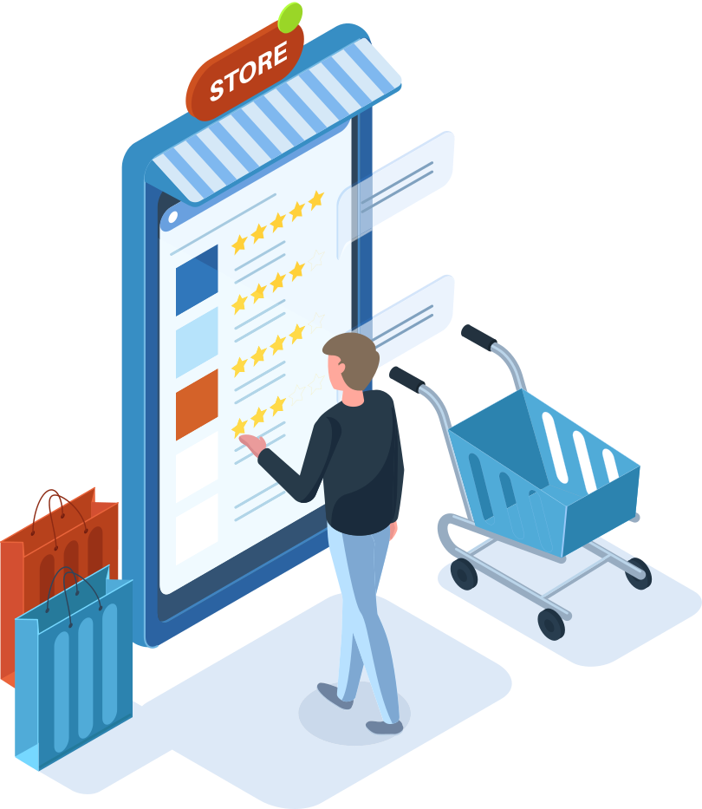
TABLE OF CONTENTS
Introduction
Data preparation
Exploratory Data Analysis
clustering
classifications
market basket analysis
Recommendations
2

Slide 3

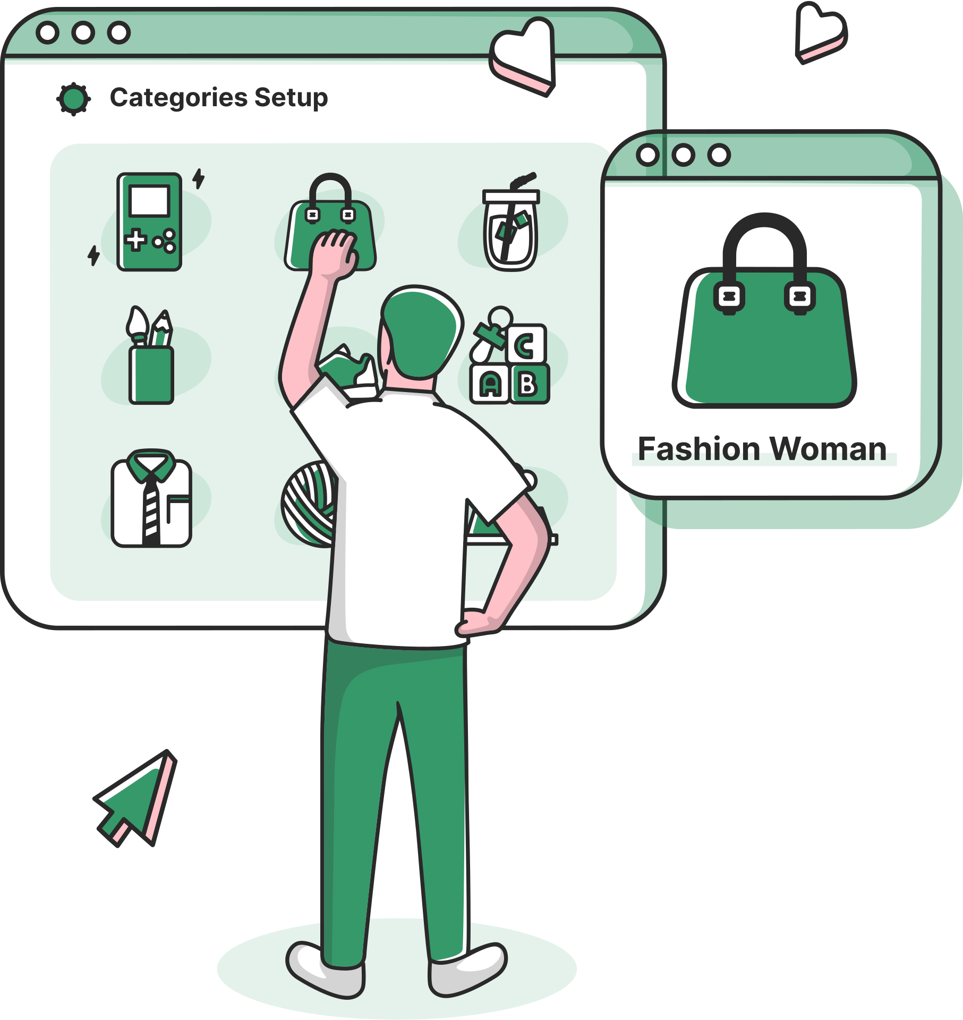
BUSINESS QUESTION
How can we classify and segment our customer base to identify high-value segments and tailor marketing strategies that maximize customer engagement and lifetime value?
3

Slide 4

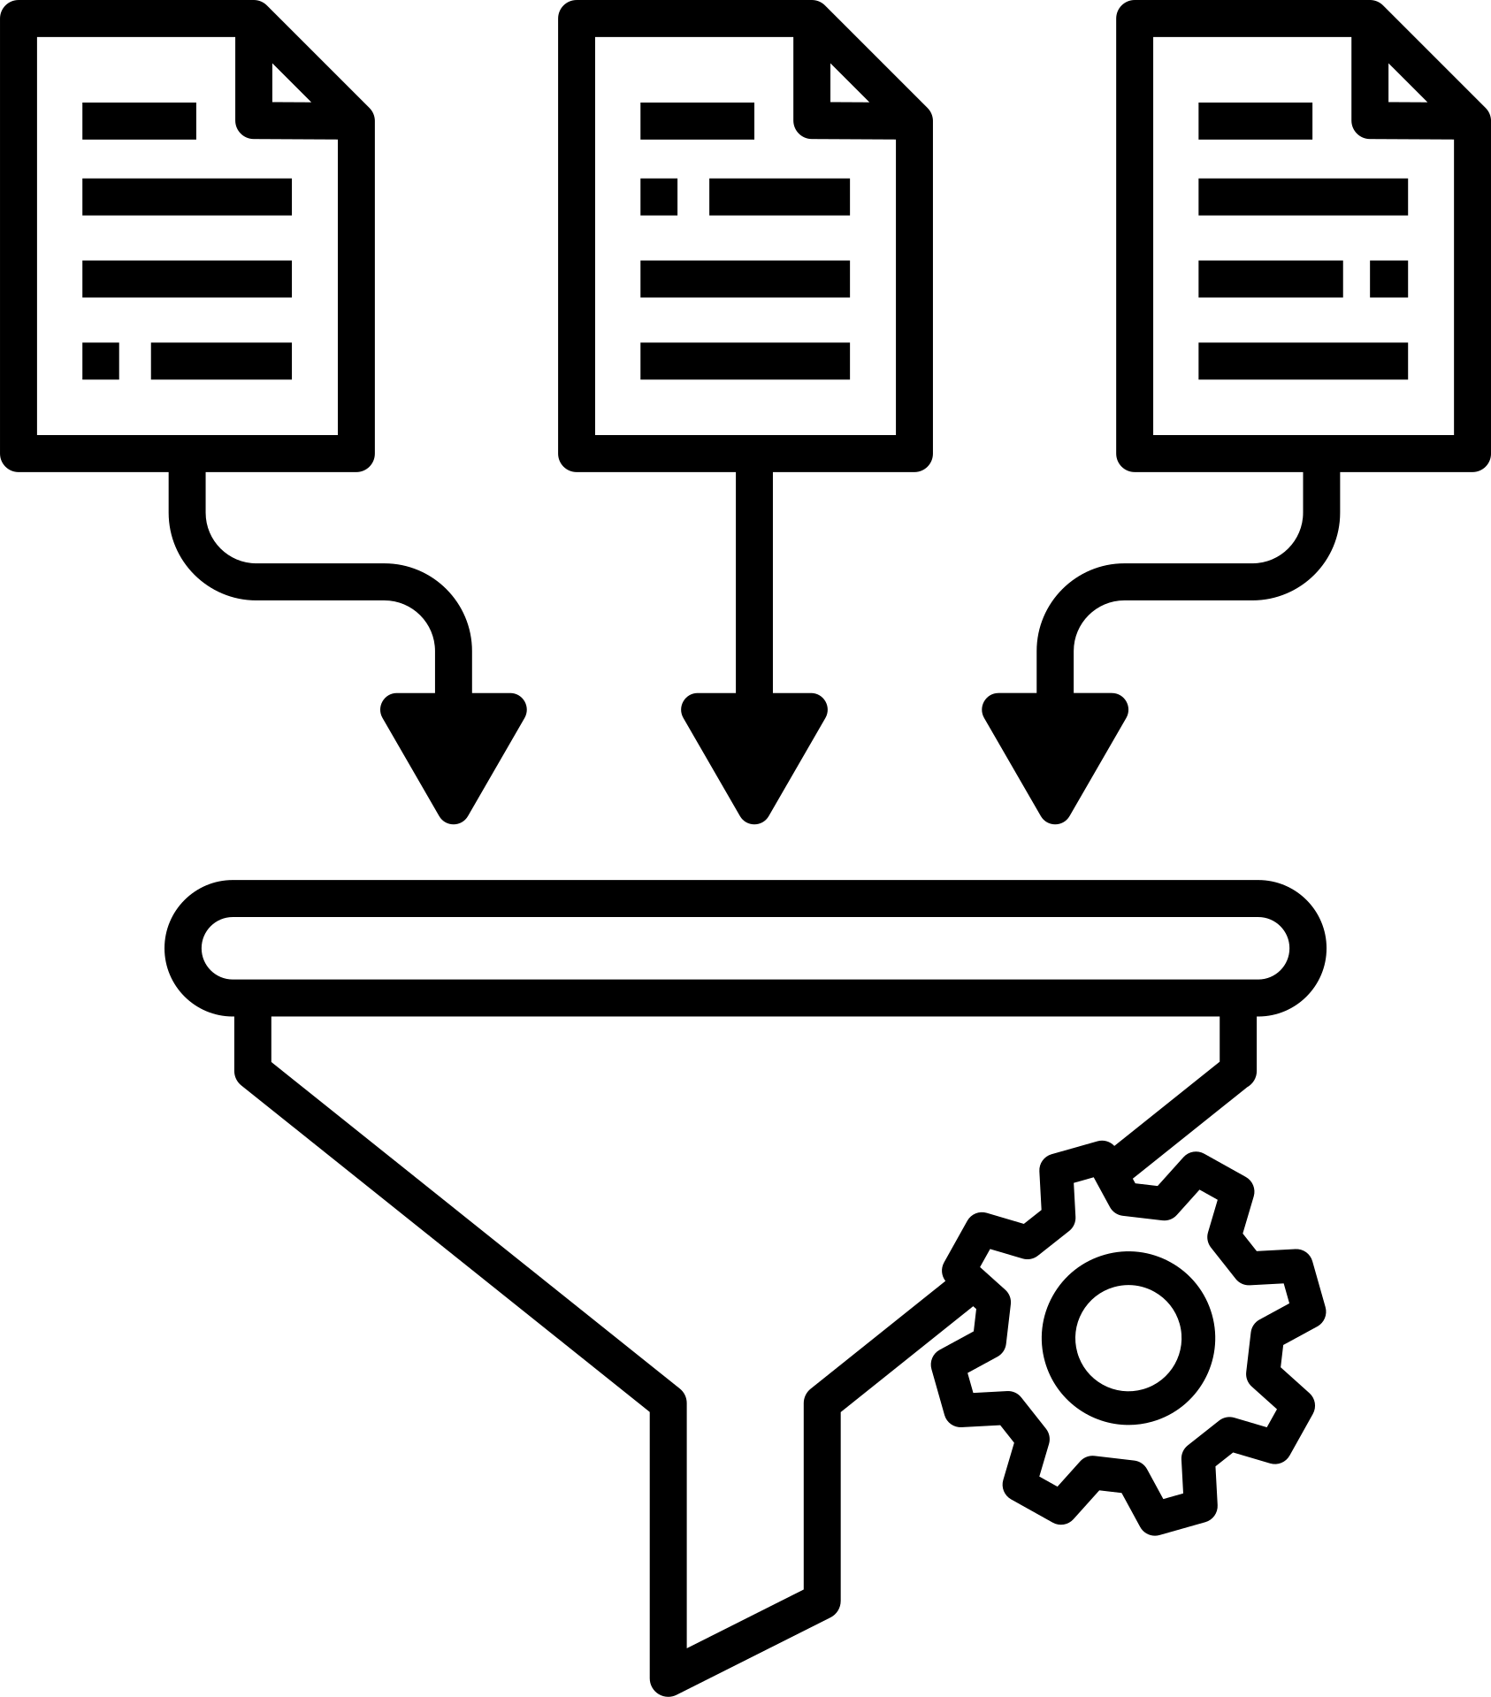


DATA PREPARATION
merging
datasets
variable
creation
data
transformation
source : kaggle
4

Slide 5

DATA
VARIABLES
Customer ID
Number of transactions
Quantity
Transaction days
Total purchase amount
Gender
Location
Tenure
Average Purchase Value (APV)
Product category
Discount (%)
TOTAL OBSERVATIONS
52,924
TOTAL CUSTOMERS
1468
5

Slide 6

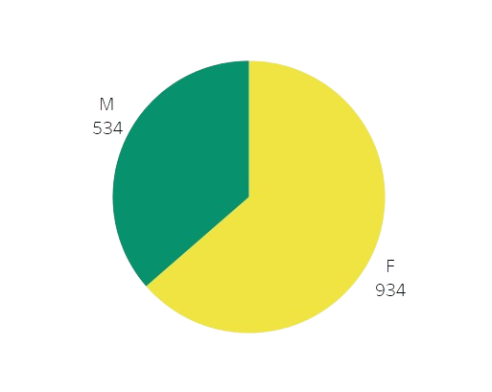
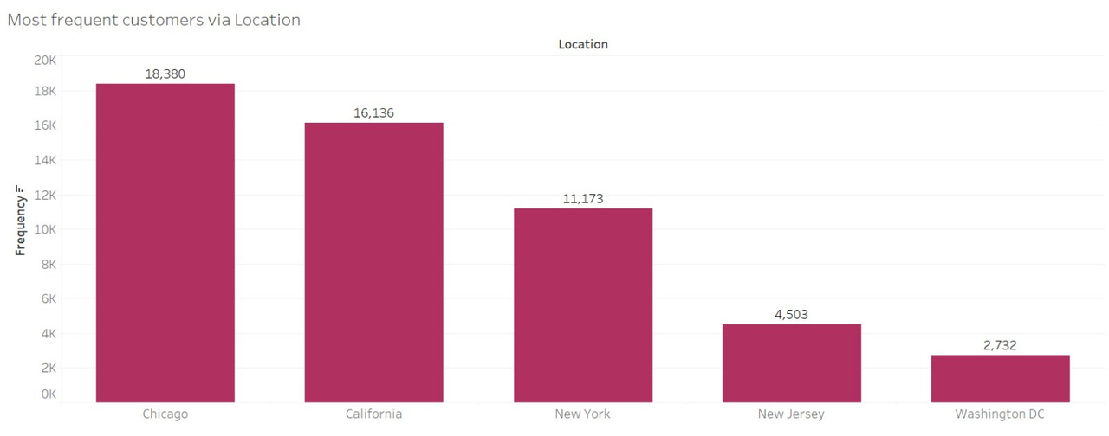
EXPLORATORY DATA ANALYSIS
GENDER
FREQUENT CUSTOMERS VIA LOCATION
6

Slide 7

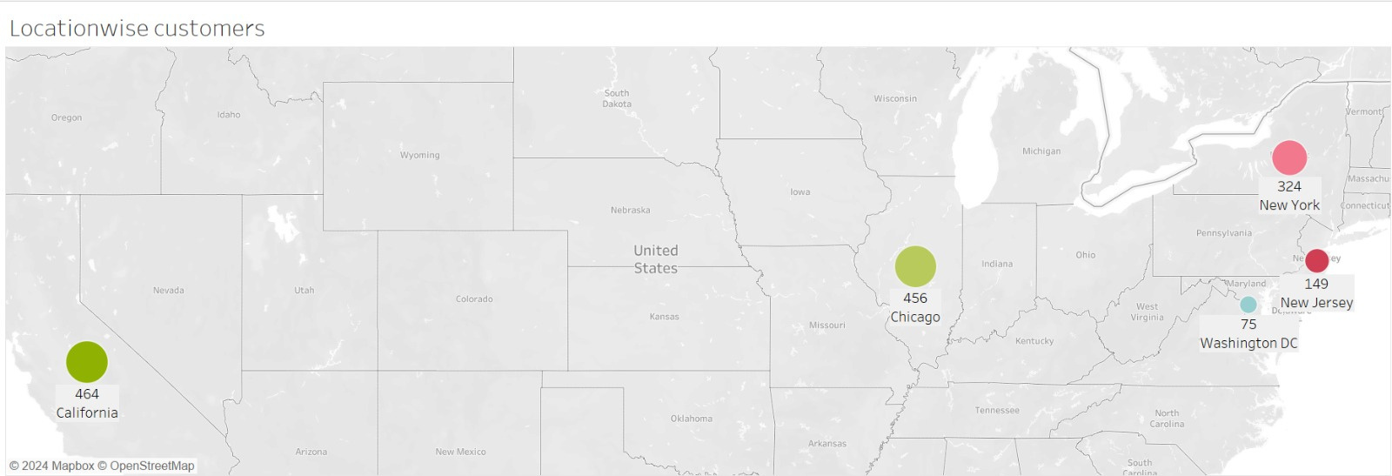
EXPLORATORY DATA ANALYSIS
LOCATIONWISE CUSTOMERS
7

Slide 8
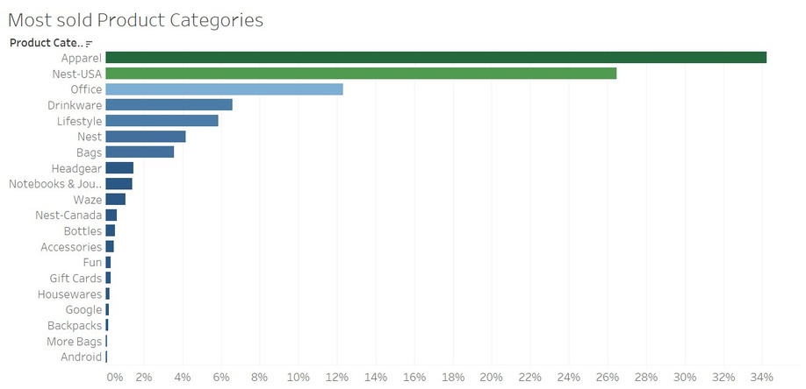
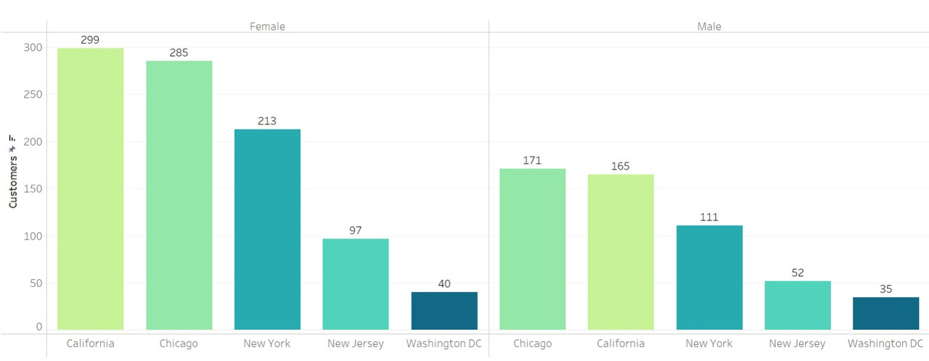
EXPLORATORY DATA ANALYSIS
MOST SOLD PRODUCTS
LOCATIONWISE CUSTOMERS
8

Slide 9


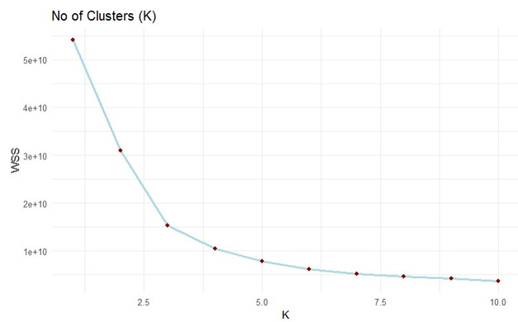
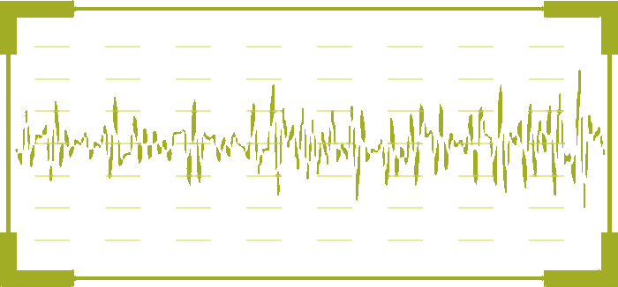




CLUSTERING
K- MEANS
VARIABLES
Grouping data into three clusters based on their similarities & behavior
RECENCY
FREQUENCY
MONETARY
CLV
9

Slide 10



PROFILING
Standard
Premium
Elite
Short customer relationship length and APV.
Least recency and infrequent purchase behavior.
Minimal monetary contribution and lowest CLV.
Located in California, predominantly female.
Moderate customer relationship length and average APV.
Somewhat recent and moderate purchase frequency.
Contribute moderately to overall monetary value and CLV.
Located in Chicago, predominantly female.
Longest customer relationship length and highest APV.
Most frequent and highly recent purchases.
Contributes the highest monetary value, APV, and CLV.
Located in Chicago, predominantly female.
10

Slide 11

CLUSTERING VS CLASSIFICATION
Using Bases, we segmented the existing customers into 3 clusters
Bases: Recency, Frequency, Monetary, Customer Lifetime Value
Using Descriptors, we classify new customers into segments
Descriptors: Location, Gender, Quantity, Product Category, Tenure
11

Slide 12
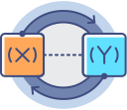
DATA FOR CLASSIFICATION
Y
X
Dependent variable
Cluster (1,2,3)
Independent variables
Quantity
Product category
Gender
Location
Tenure (months)
12

Slide 13
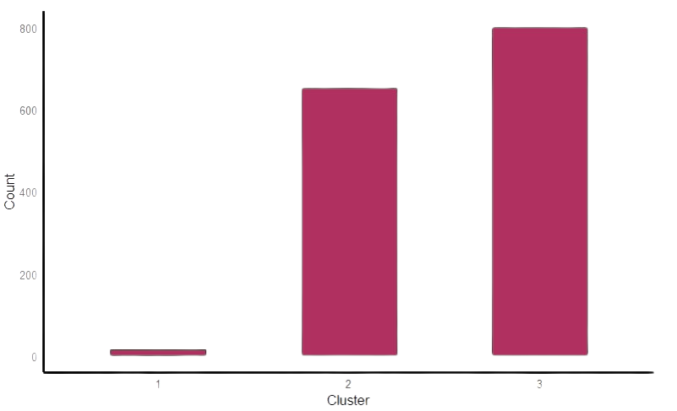
DATA PARTIONING
Balanced the data by upsampling
Portitioned the data raining into
70%
30%
Training dataset
Holdout set
13

Slide 14

CLASSIFICATIONS
MODEL:
Cluster ~ Quantity + Product Category + Gender + Location + Tenure Months
Model | multinominal | random forest | knn | xgboost
accuracy | 69.3% | 72.3% | 69.5% | 72.7%
AUC | 83.3% | 85.4% | 84.3% | 85.6%
14

Slide 15

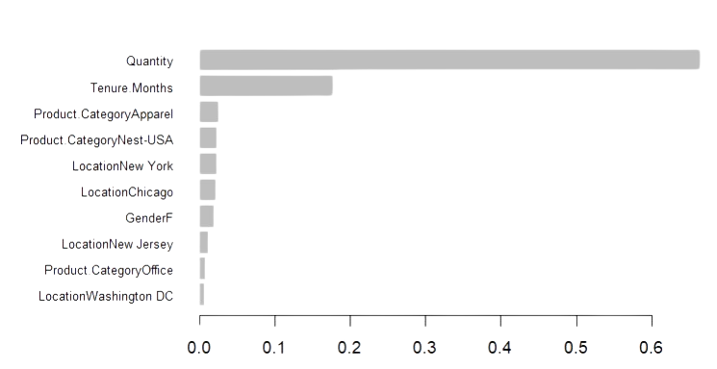
XGBOOST
= 0.3
FEATURE IMPORTANCE PLOT
MAX DEPTH
6
NROUND
100
15

Slide 16

MARKET BASKET ANALYSIS
ASSOCIATION RULE
P(Drinkware)
Antecedents | Consequents | Support | Confidence | Lift
Bags, office | Drinkware | 0.01428514 | 0.5424242 | 5.385774
Bags, Lifestyle | Office | 0.01017517 | 0.6800000 | 4.833091
Bags, Drinkware | Office | 0.01428514 | 0.6580882 | 4.677354
Drinkware, Lifestyle | Office | 0.01671921 | 0.6466049 | 4.595736
Notebook & Journals | Office | 0.01384622 | 0.5596774 | 3.9977900
Apparel, Lifestyle | Office | 0.01707833 | 0.5162847 | 3.669487
Lifestyle | Office | 0.03511432 | 0.5140187 | 3.653381
Headgear | Apparel | 0.01731774 | 0.6439169 | 1.985140
Drinkware, Lifestyle | Apparel | 0.01356690 | 0.5246914 | 1.617578
Chance of buying Drinkware compared to randomly suggesting an item
16

Slide 17
RECOMMENDATION
Location-Based Targeting: Focus marketing efforts on Chicago and California, the regions with the highest monetary value, using geo-targeted campaigns and localized promotions.
Dynamic Discount Strategies: Test varying discount rates to analyze customer responsiveness and identify their impact on cluster migration and overall engagement.
Tailored Pricing Models: Implement premium pricing for high-CLV customers and value-based pricing for low-CLV customers to maximize revenue and engagement.
Product Bundling: Use market basket analysis insights to create combo offers that cater to customer preferences, driving cross-sell and upsell opportunities.
Tiered Loyalty Program: Introduce a points-based system to reward purchases, encouraging customers to move through Standard, Premium, and Elite tiers with increasing benefits.
17

Slide 18


Thank
you!
18

Slide 19
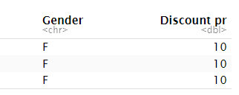
APPENDIX
PROFILING RESULT
19

Slide 20
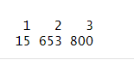
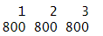
APPENDIX
UP SAMPLING RESULT
BEFORE SAMPLING
AFTER SAMPLING
20

Slide 21
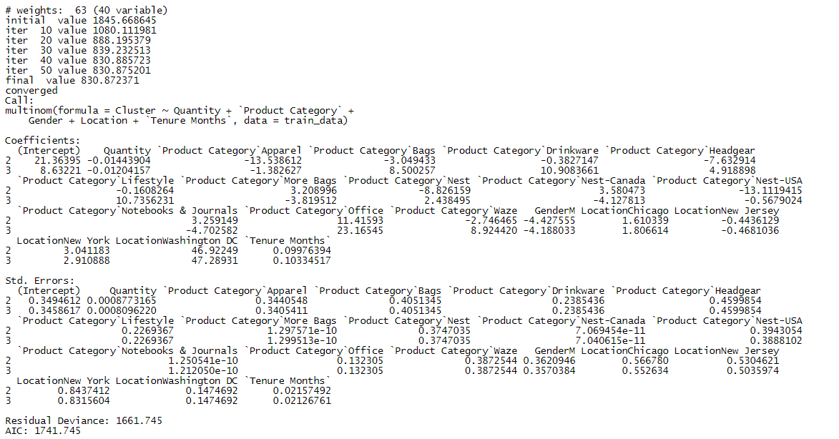
APPENDIX
LOGISTIC REGRESSION
21

Slide 22
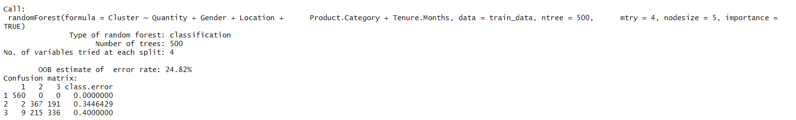
APPENDIX
RANDOM FOREST OUTPUT
22

Slide 23
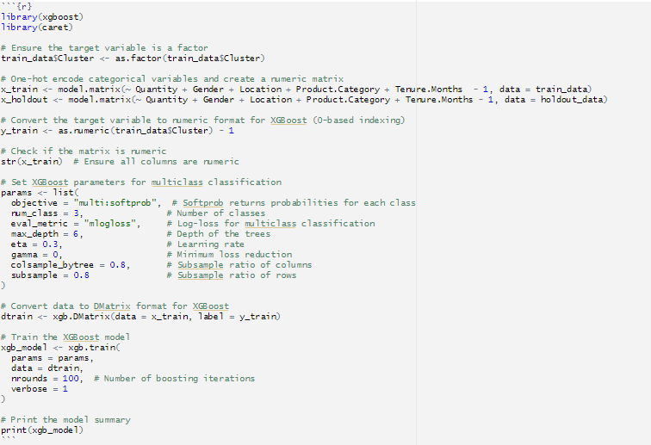
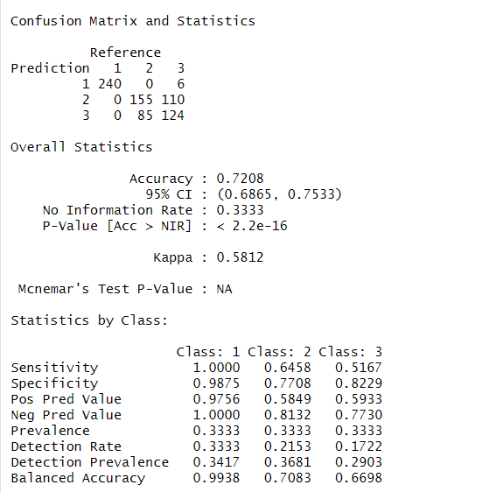
APPENDIX
XGBOOST RESULTS
23

Slide 24
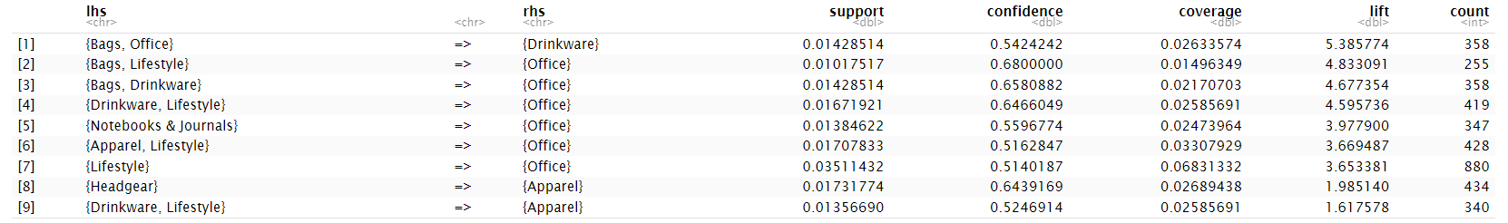
APPENDIX
MARKET BASKET ANALYSIS(APRIORI ALGORITHM)
24

Slide 25
APPENDIX
LINK TO THE SLIDE
https://www.canva.com/design/DAGYSC8q4qA/vEQe3DABqhE_BUbLMexPXQ/edit?utm_content=DAGYSC8q4qA&utm_campaign=designshare&utm_medium=link2&utm_source=sharebutton
25

